Slide 1
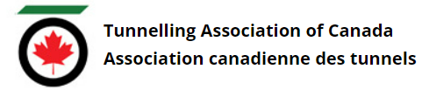
Tunnelling Association of Canada
Equity, Diversity, and Inclusion Moment
Universal Accessibility

Slide 2
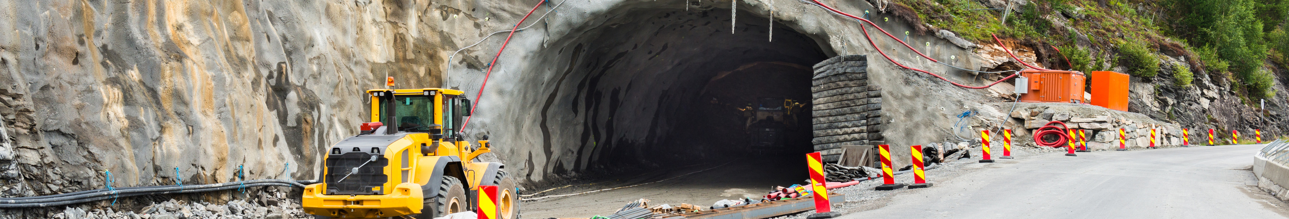
Tunnelling Association of Canada
What is universal accessibility?
Universal accessibility is the principle that products, buildings, and environments should be designed to be accessible to all people, regardless of their age, size, ability or disability.
Universal accessibility is beneficial to everyone - removing barriers to access can have positive effects on people with different life circumstances.
2

Slide 3
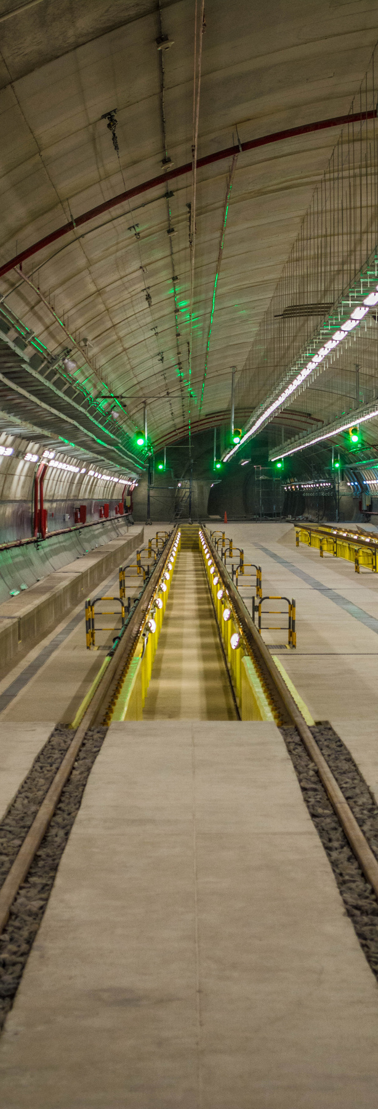
Tunnelling Association of Canada
Universal Accessibility in the Workplace
Example 1
Closed Captions
Example 2
Flexible Hours
Example 3
Virtual Attendance Options
Closed captions on virtual meetings are beneficial to people with hearing loss, and people travelling or unable to connect to audio.
Flexible work hours (when practical) benefit people with disabilities, chronic pain or other health concerns, as well as parents, commuters, and others who have scheduling constraints.
Giving participants the option to access meetings or events virtually improves accessibility to all – including those with health concerns, and those with family or other commitments.
Even if virtual participants can't get the full experience, some will attend virtually who otherwise wouldn't have been able to attend in person.
6

Slide 4
Tunnelling Association of Canada
Thank you!
The End

